Slide 1
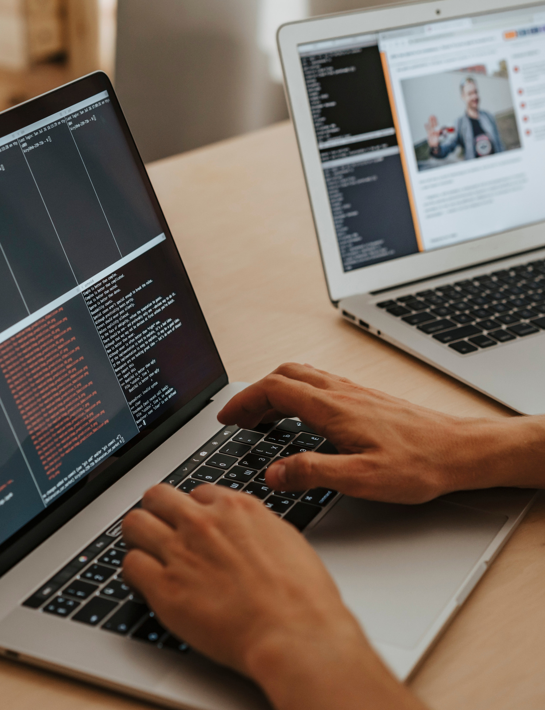



PROGRAMMING

Slide 2
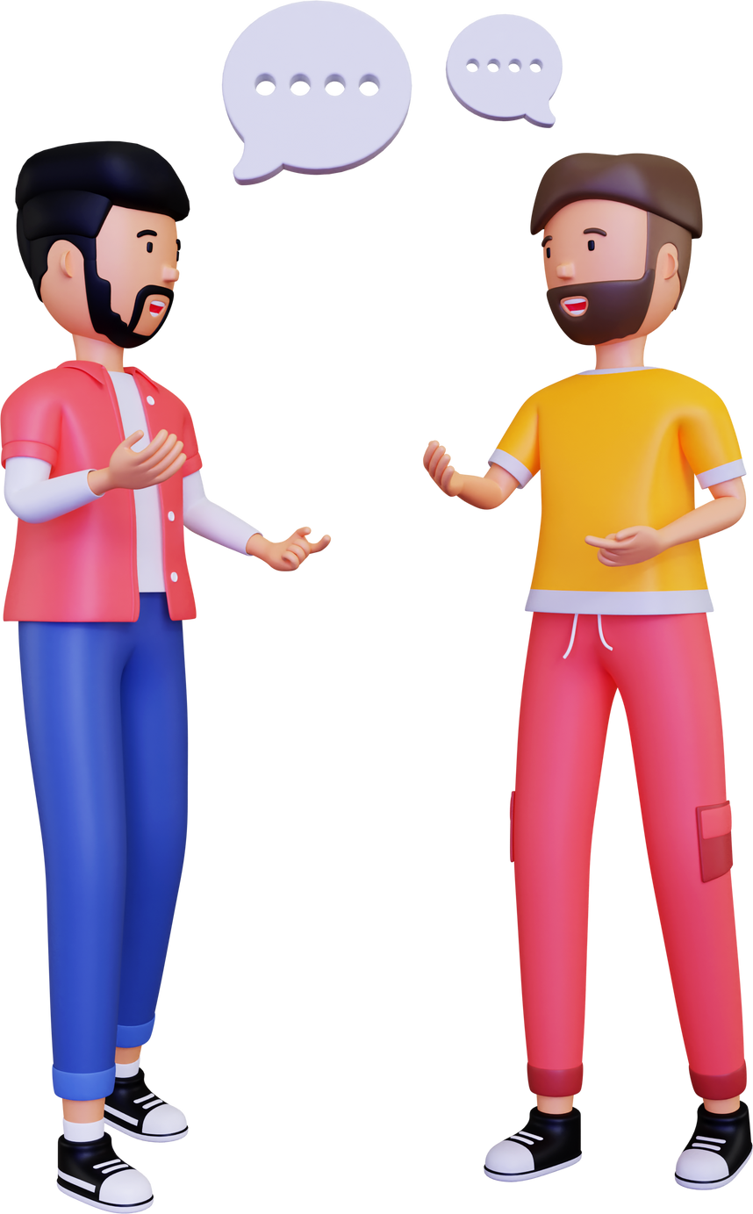


Humans use Native Language to communicate

Slide 3
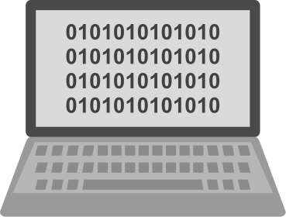

Computers can't understand native languages
They understand only 0s and 1s

Slide 4



Slide 5


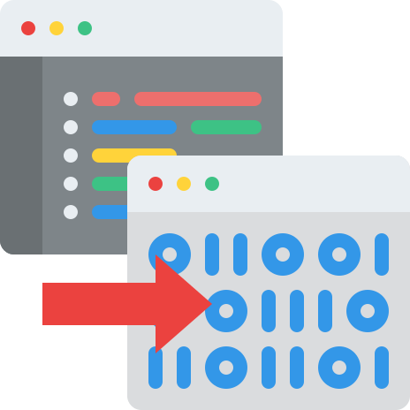
Compiler
Intrepetor

Slide 6
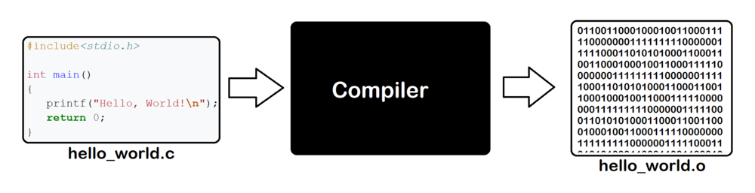
The compiler scans the whole program in one go.
Interpreter translates the program one statement at a time.

Slide 7

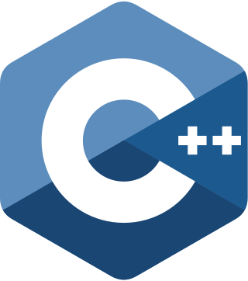




What are the Top Programming languages ?

Slide 8

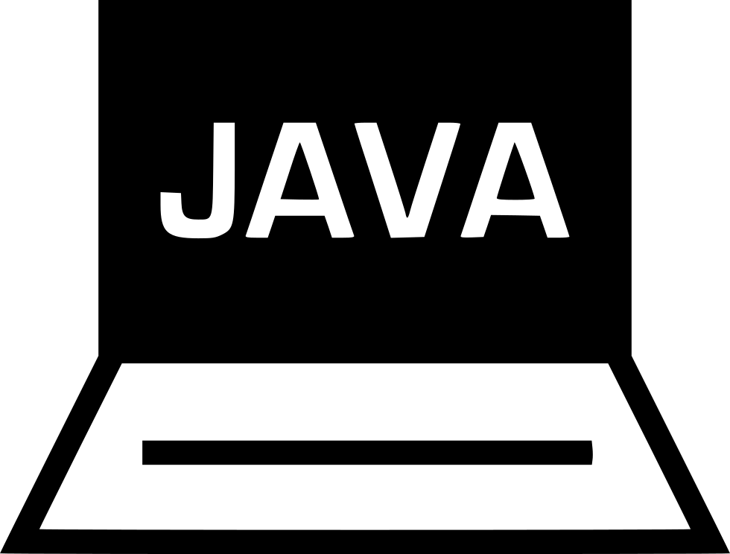


Slide 9




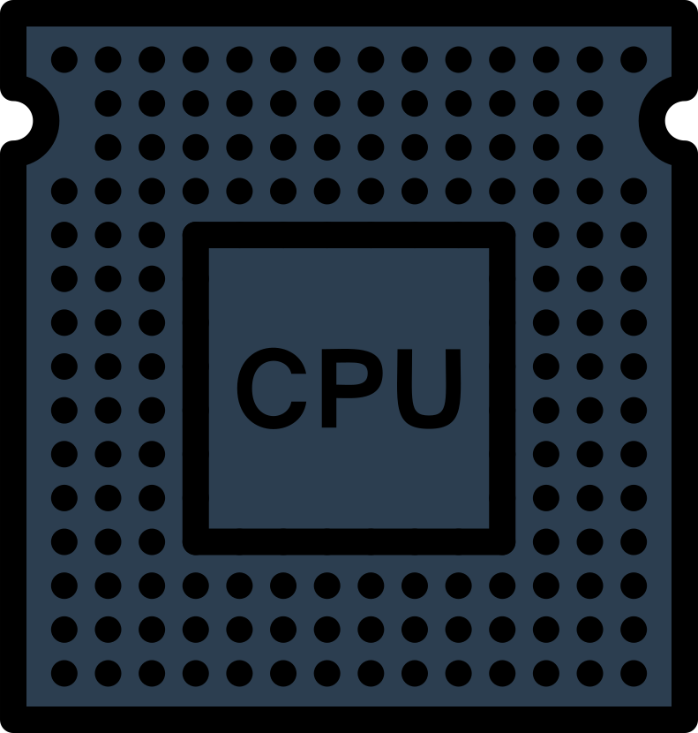

Is it because of

Slide 10





Or Is it because of
Is it because of 27 years of legacy?
Is it because of the high pay in the market?
Is it because of the high popularity name & fame?

Slide 11
Java is being developed
Considering drawbacks of C &C++.
Large community support world wide.
Wide range of Libraries & Frame Works(springboot)
It is a very backwards compatible language

Slide 12

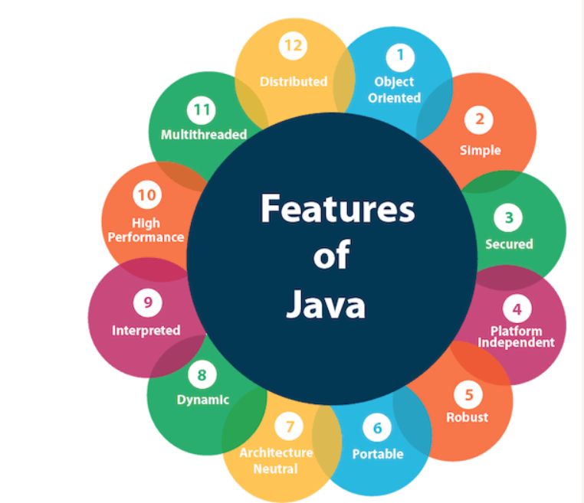
Features of Java
Platform independent
Object-orientated
Strongly-typed language
Automatic memory management
MultiThreaded

Slide 13




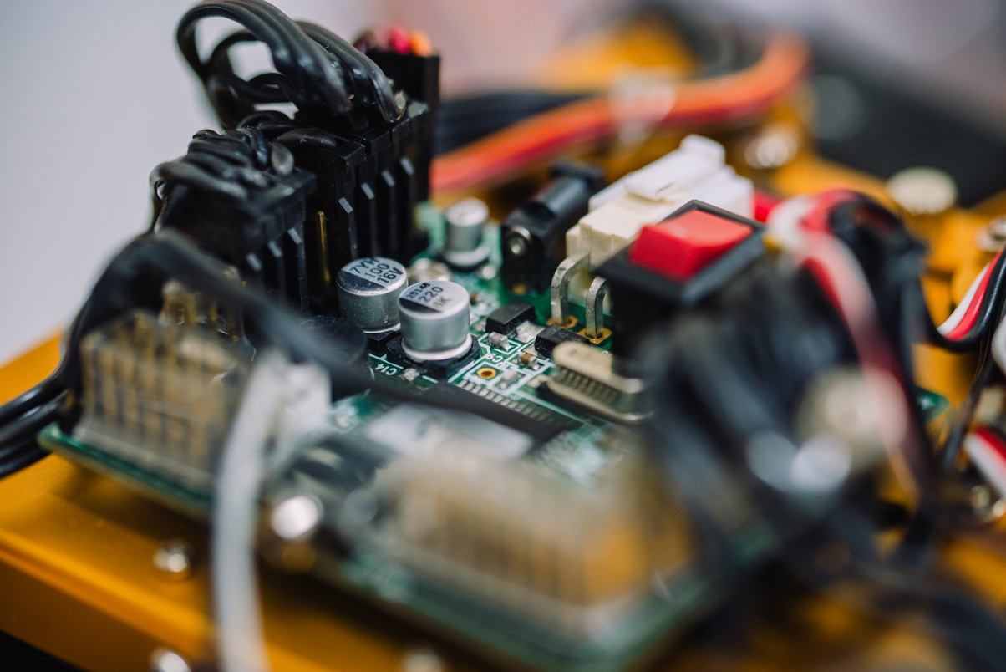

Where are we using Java ?

Slide 14



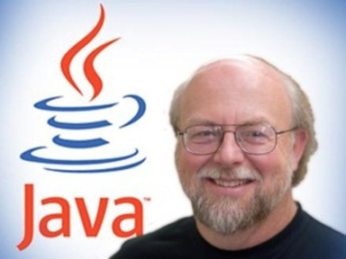
Java is an OOP language developed by James Gosling in the early 1990s.
Java beta version release in 1995 and 1996 JDK-1.0 released
Java 8 launched in March 2014
Current Java version is 18 March 2022
Currently java owned by Oracle which has acquired Sun Sys..

Slide 15


How to Install Java ?

Slide 16





Slide 17



My First Program

